Slide 1



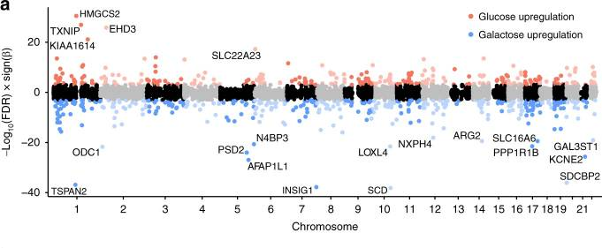

Human fetal Retinal Pigment Epithelium gene expression suggest ocular disease mechanisms
Lisa Hu
Bio-informatics – BFV2
Institute of Life Science & Tech l.j.b.hu@st.hanze.nl
References https://www.ncbi.nlm.nih.gov/geo/query/acc.cgi?acc=GSE129479 https://www.ncbi.nlm.nih.gov/pmc/articles/PMC6527609/
Introduction
The retinal pigment epithelium (RPE) is the pigmented layer of cells in the retina of the eye that serves vital roles in the visual mechanisms. Genetic variants that affect the RPE gene expression could lead to various ocular diseases. By examining genetics of gene expression of cultured human fetal RPE (fRPE) cells under two different metabolic conditions, these genetic variants could be elucidated.
[[what did I do?]]
Materials and Methods
24 Homo sapiens | fRPE cell lines | 48 glucose/galactose samples

